Slide 1
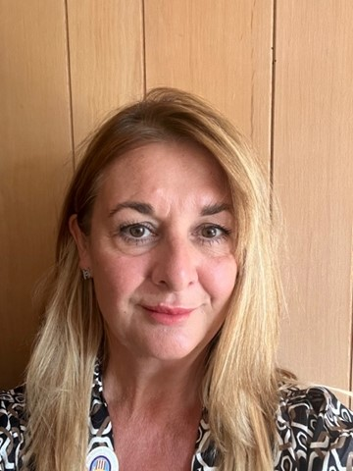
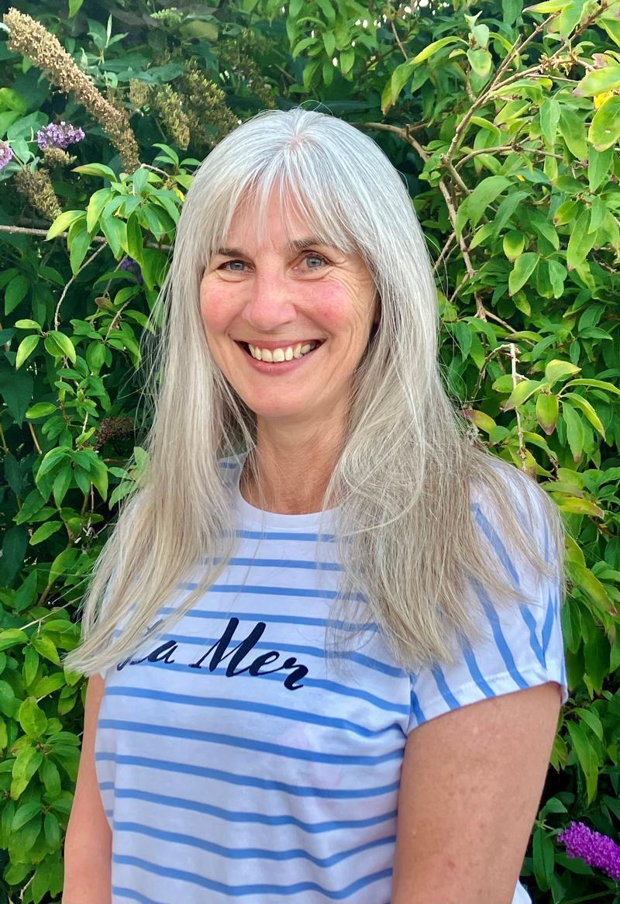
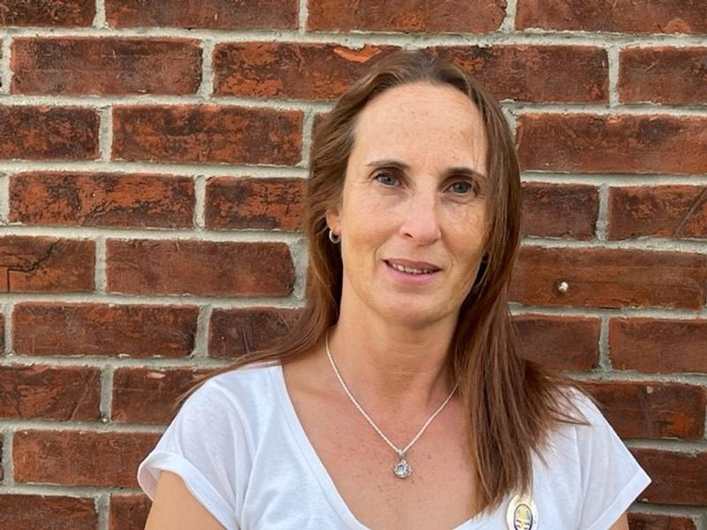
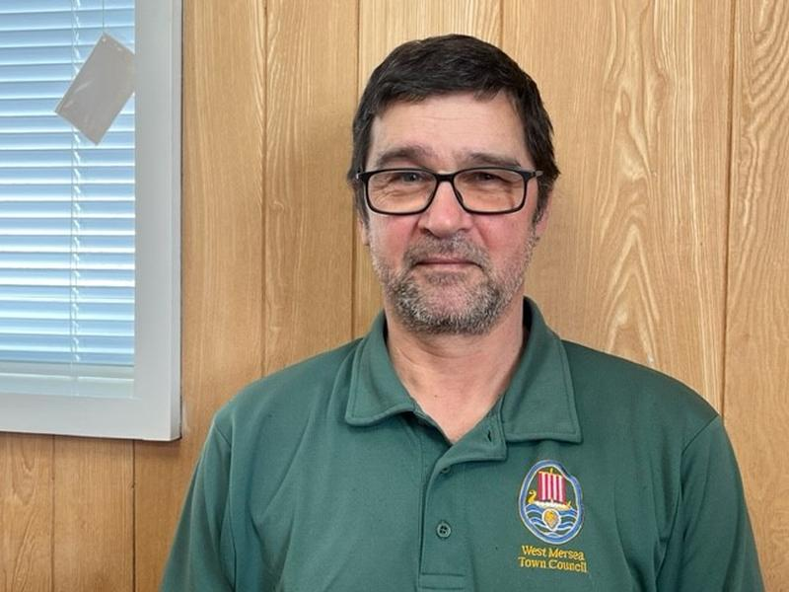
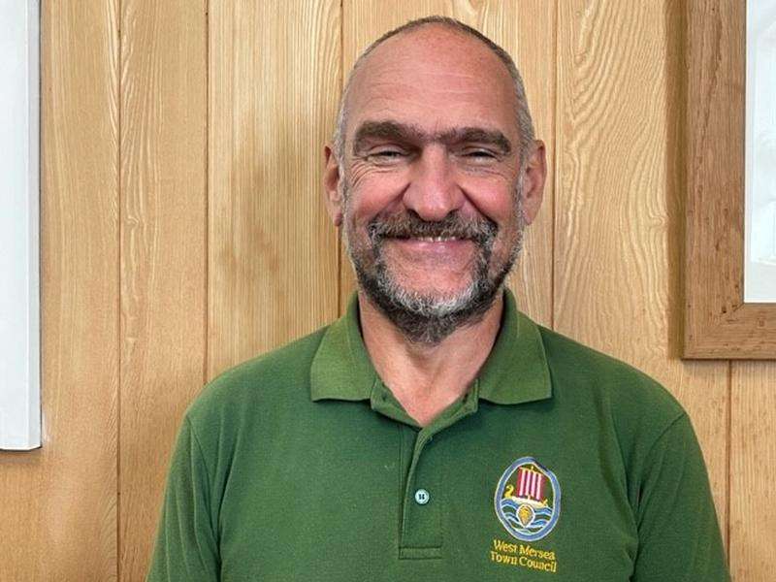
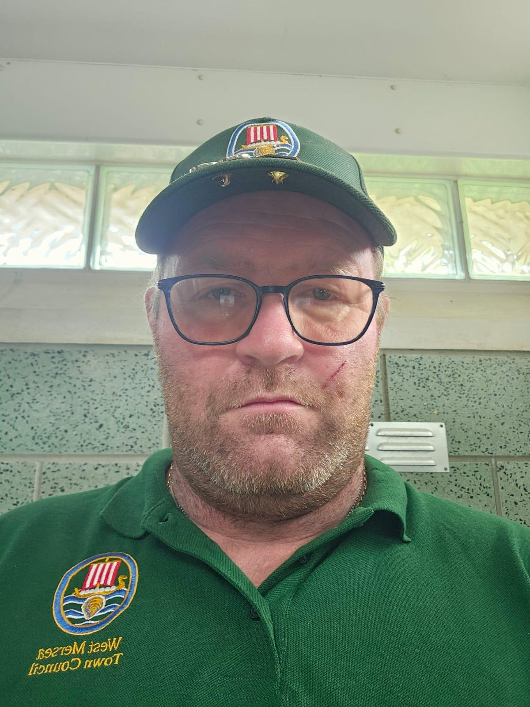
STAFF ORGANISATIONAL CHART
Karen Kuderovitch, CILCA
Town Clerk & RFO
Carol Fountain
Cemetery Clerk/ Assistant to Town Clerk
Hayley Powling
Admin Assistant
Paula Whitting
Litter Picker/Gardener/
Housekeeper
William Boswick
Senior Grounds person
Gary Petley
Grounds person
Mark Coombs
Grounds person
Mon - Fri 8am - 4pm
Mon & Fri 9am - noon Tues 9am - 3pm
Varied
Mon - Thurs 8am - 5pm
Friday 8am - 4pm
Mon - Thurs 8am - 5pm
Mon - Thurs 8am - 5pm
Friday 8am - 4pm

